Slide 1
COMP 4332 / RMBI 4310 Big Data Mining (Spring 2023)
Project 1: Sentiment Analysis
TA: Van Quyet DO (vqdo@connect.ust.hk)

Slide 2
Sentiment Analysis
Generally modeled as classification or regression task
predict a binary or ordinal label

Slide 3
Sentiment Analysis
Simplest task:
Is the attitude of this text positive or negative?
More complex:
Rank the attitude of this text from 1 to 5
(3/5) The room was clean and everything worked fine – even the water pressure
(1/5) …the worst hotel I had ever stayed at ...
Advanced:
Detect the target, source, or complex attitude types

Slide 4
Pipeline
Data Loader: Load data from disks
Feature Extraction: Find useful features
Learning: Classification via different classifiers
For more information and examples, please refer to instruction.ipynb
If you want to quickly get familiar with the whole pipeline, please refer to general_pipeline.ipynb

Slide 5
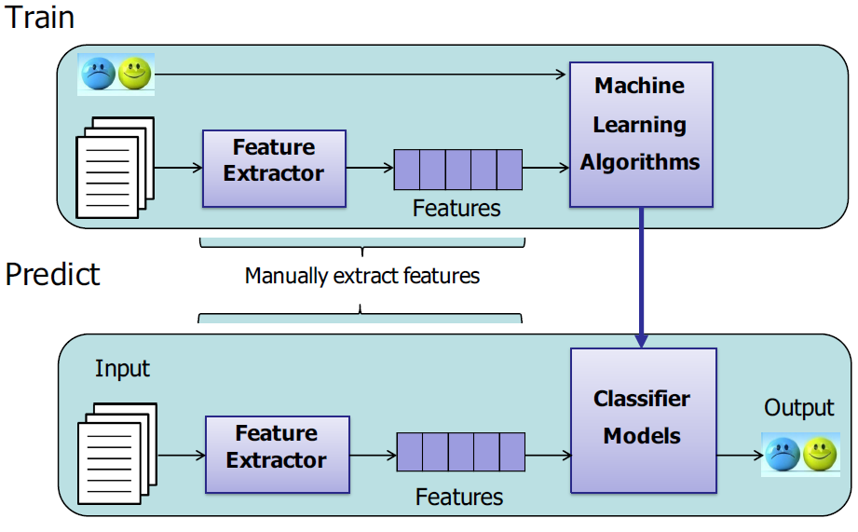
Pipeline

Slide 6
Feature Extraction
word occurrence, word frequency, or TF-IDF
This room is clean.
[0,0,1,1,0,1,0,0,1,0,1]
word embedding
cbow, skip-gram, GloVe, fasttext
contextualized word representation
ELMo, BERT, GPT, GPT-2

Slide 7
Feature Extraction
user information
nationality
age
date
weekday or weekend
holiday?
hotel rating
Hilton Hotel
Youth Hostel

Slide 8
Classification
Naïve Bayes
Logistic Regression
Support Vector Machine
Deep Learning

Slide 9
Multi Layer Perceptron
activation
Output
Hidden
Input
Demo: http://playground.tensorflow.org/

Slide 10
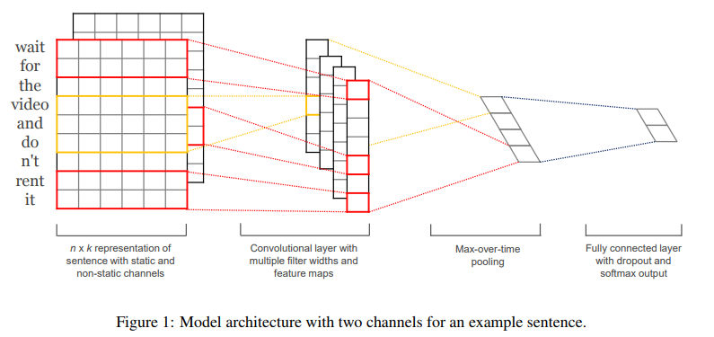
CNN

Slide 11
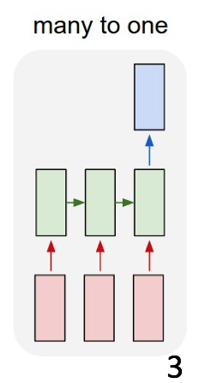
RNN

Slide 12
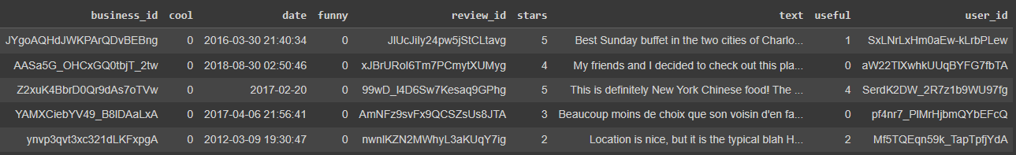
Dataset
training data: 18000 reviews
validation data: 2000 reviews
test data: 4000 reviews
stars (integer, to be predicted): 1-5
given features: business_id, cool, date, funny, review_id, text, useful, user_id

Slide 13
Evaluation
Macro F1 on test data
You would not get the test labels, but you can use the provided validation set to estimate your model’s performance

Slide 14
Important dates
Four weeks in total
[March 16, 2023] Project starts
[March 23, 2023] TA will release the validation performance of a weak baseline
[March 30, 2023] TA will release the validation performance of a strong baseline
[April 13, 2023, 23:59] Submission deadline
Notes:
Note: April 5 -> 11 is midterm break, thus shouldn’t set any event on these days

Slide 15
Submission
Predictions file pred.csv on test data (before submitting your test predictions, please make sure you can successfully evaluate your validation predictions on the validation data with the help of evaluate.py)
Report (1~2 pages)
Code (Frameworks and even programming languages are not restricted.)
DDL: April 13, 2023
Submission: Each team leader is required to submit the groupNo.zip file that contains pred.csv, the report, and your team’s code on Canvas.
We will check your report with your code and the model performance (in terms of macro F1) on the test set.

Slide 16
Grading Rule
Grade | Classifier (80%) | Report (20%)
50% | example code in tutorials or in Project 1 without any modification | submission
60% | an easy baseline that most students can outperform | algorithm you used
80% | a competitive baseline that about half students can surpass | detailed explanation
90% | a very competitive baseline without any special mechanism | detailed explanation and analysis, such as explorative data analysis, hyperparameters and ablation studies
100% | a very competitive baseline with at least one mechanism | excellent ideas, detailed explanation and solid analysis

Slide 17
Thank You and Good Luck

